Slide 1

Retinal Imaging Data Analysis
Davin Miller

Slide 2
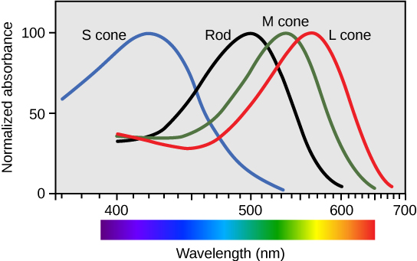
Introduction
Cone cells – photoreceptor cells in the human’s retina
Responsible for producing color vision at appropriate light levels
Cells differentiate by being sensitive to different wave lengths
S-cones: short wavelengths (e.g. violet, blue)
M-cones: medium wavelengths (e.g. green)
L-cones: long wavelengths (e.g. red)
Can be important to distinguish between cones
Used to recognize different forms of colorblindness

Slide 3
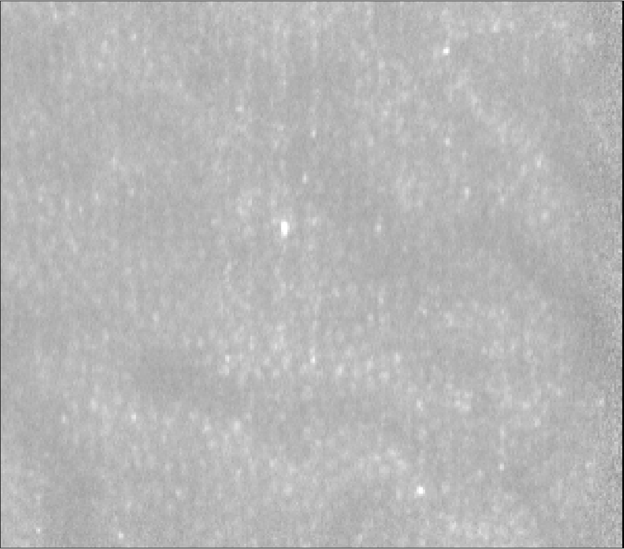
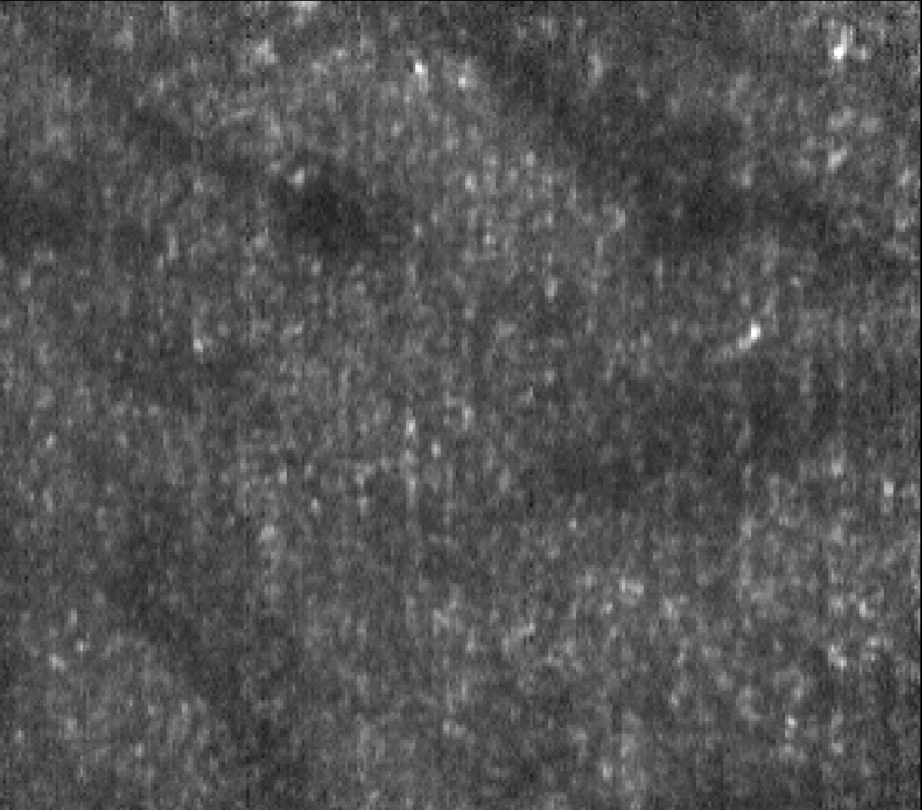
Lab Work
Dr. Donald Miller’s lab at Indiana University attained reflection images of the rear retina via retinal scanning
Classified cones as short, medium, or long
Each cone contained 3D measurements of its aperture
Subject 53 Reflection
Subject 130 Reflection

Slide 4
The Data
Measurements
3 subjects containing ~2400 total data points
Each data point represents a cone cell and contains 9 variables
Measurements include: Coordinate(x,y), ISOS(x,y,z), COST(x,y,z), and Cone Type
Variables
Coordinate: lateral coordinates of the cones
ISOS size x, ISOS size y: aperature size of IS cones in x-y direction
ISOS z: reflection of distance between External Limiting Membrane and ISOS boundary
COST size x, COST size y: aperture size of OS cone in x-y directions
COST z: reflection of distance between External Limiting Membrane and COST (tip)
Example row of one data point

Slide 5

Purpose
This project has two main goals
Identify variables with the most significant difference between cone types (S, M and L)
Use Algorithmic tests to see if these significant variables can reliably distinguish cone types from each other.

Slide 6
Predicted Results
Short cones are known to have longer inner segment lengths than Medium and Long cones.
ISOS z variable should on average be larger than M and L.
Medium and Long cones are very similar in structure.
It is likely that it will be very difficult to distinguish between these two groups.
Many, if not all variables, will test not significant when comparing groups M and L.

Slide 7

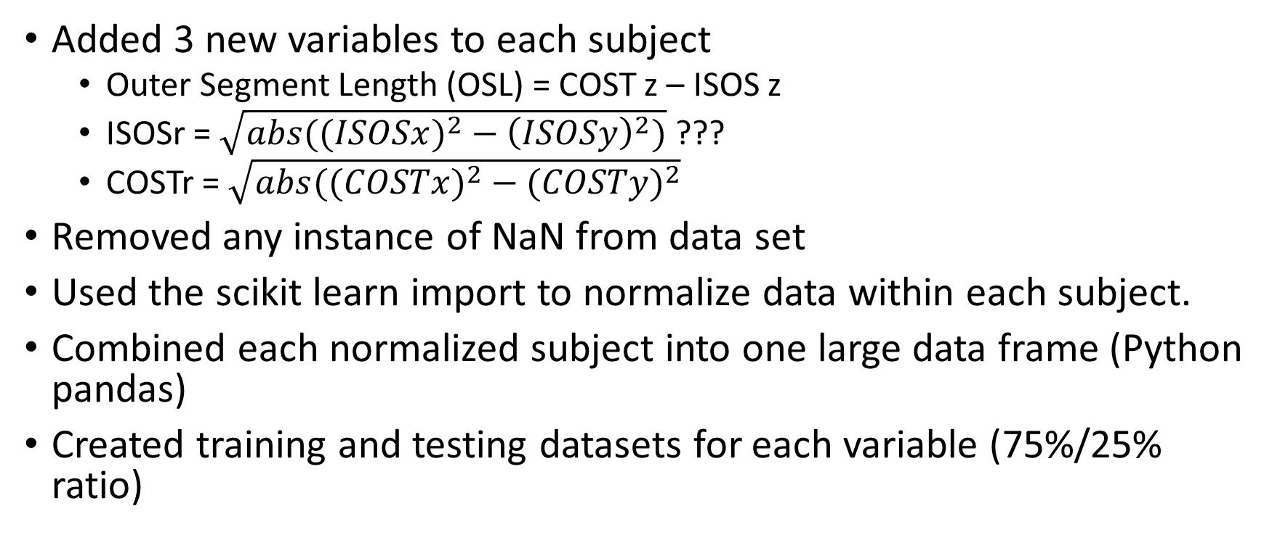
Data Preprocessing
Added 3 new variables to each subject
Outer Segment Length (OSL) = COST z – ISOS z
ISOSr = $\sqrt{{abs((ISOSx)}^{2}−{\left(ISOSy\right)}^{2})}$ ???
COSTr = $\sqrt{abs(({COSTx)}^{2}−{(COSTy)}^{2}}$
Removed any instance of NaN from data set
Used the scikit learn import to normalize data within each subject.
Combined each normalized subject into one large data frame (Python pandas)
Created training and testing datasets for each variable (75%/25% ratio)

Slide 8
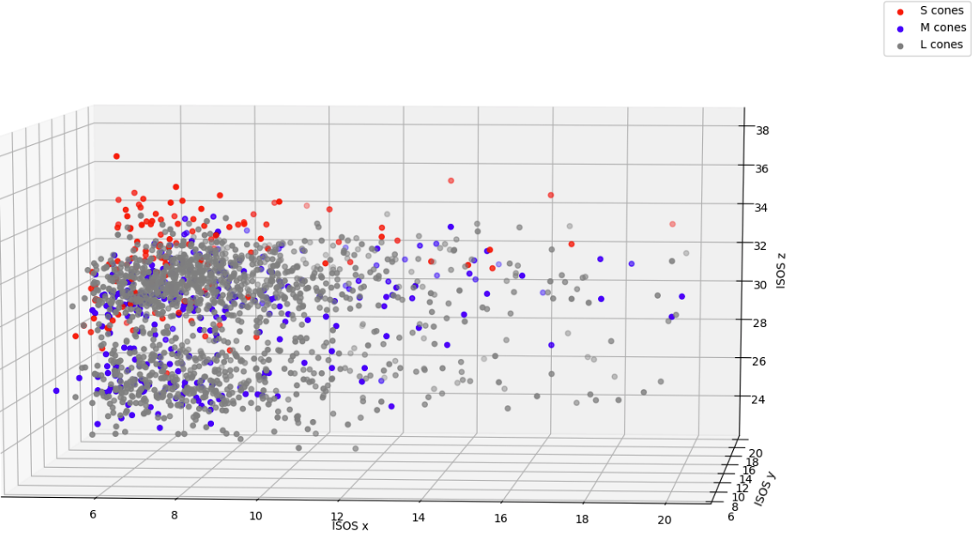
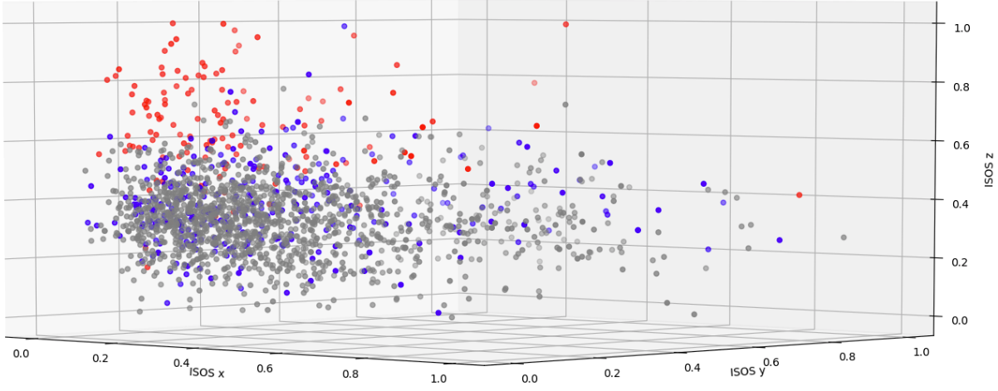
Why Normalize?
Data between subjects vary
Measurements in one subject are not concurrent with another
Creates an easy way to combine all the subject’s data together without losing the scope of each variable
Notice in Figure 1 that the data is split into two clusters
The bottom cluster represents data from one subject while the top cluster represents the data from the other two subjects
In Figure two, normalization removes any cluster between subjects, and we can see a more consistent separation in red dots (S cones)
Non-normalized data (Fig 1)
Normalized data (Fig 2)

Slide 9
Part 1: Tools for Testing Significance
We need a test that can quickly perform significance tests on multiple variables between 3 sets of data
The ANOVA test allows us to test the significance of the differences between two or more means
In this case, we want to find variables that are significant in differentiating cone type
If the ANOVA test for a variable returns insignificant (p>.01), then we know that the variable is similar among all cone types
If the ANOVA test for a variable returns significant (p<.01), we want to perform a Post Hoc Tukey test to determine which cone matchup (S:M, S:L, M:L) contributed to the overall finding of significance
For example, it is likely that a variable is significant because it differs in S cones when compared to M or L cones

Slide 10
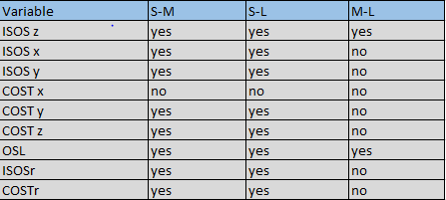
Testing Significance of Variables For Differentiating Cone Type
ANOVA tests
Post Hoc Tukey Test for Significance
Noteworthy Results
8 of 9 variables were found to be significant
ISOS z and OSL are the most significant
Tukey test also recognizes a significant difference between M-L cones for these variables.
*Yes = significant, no = insignificant

Slide 11
Graphing Visualization for Significant Tests
Do the results correlate with their respective graphs?
Each bar represents the average measurement of a variable in each cone, with standard error lines

Slide 12
Continued…
Note: If the black error lines cross between any two bars, then that variable is NOT significant between those two cone types

Slide 13
Part 2: Analysis
Because we know the cone type classification in our training/testing dataset and want to directly use the variables that are most significant, we performed supervised algorithms
Algorithms tested:
KNN (nearest neighbor)
Support Vector Machines (SVM)
Neural Networks
K Means Clustering
Decided against unsupervised algorithms
We need specific classification results (S, M or L cone) that an unsupervised method wouldn’t produce
These algorithms would create unknown weights on each variable, making its process of producing an output unknown.

Slide 14
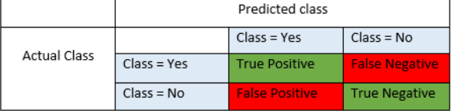
Understanding the Results: True positive, False Positive, False Negative, True Negative
Before we show the results of our algorithms, it is important to understand what these values mean.
True positive (tp): predicted class and actual class both predict the target class (in the picture example, both are yes)
False positive (fp): algorithm predicts target class but is wrong
False negative (fn): algorithm doesn’t predict target class, but is wrong
True negative (tn): algorithm doesn’t predict target class, and is correct
With multiple variables, for example x, y and z, this represents the algorithm simply saying, “it’s not x”. If the true value is y or z, the algorithm would be correct in its statement.

Slide 15
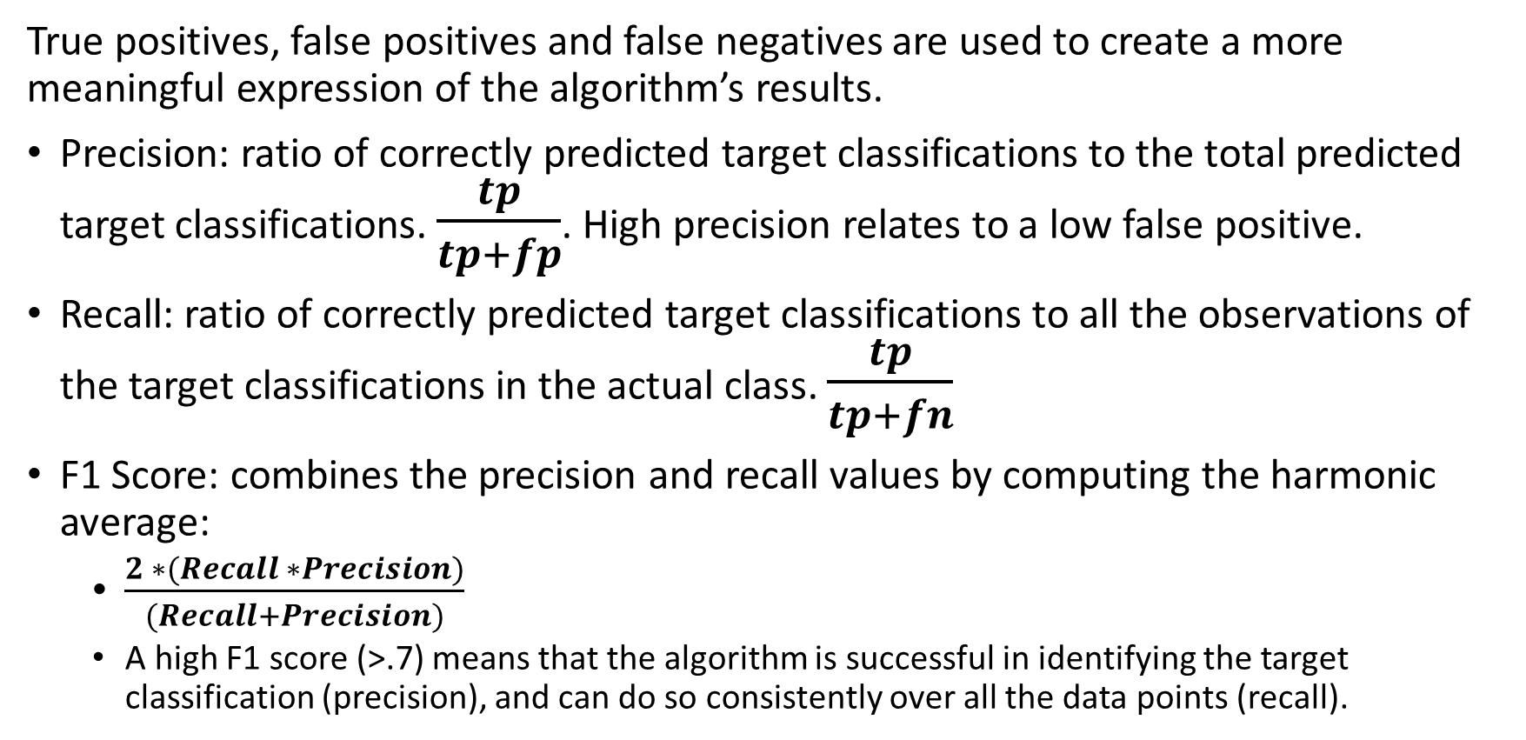
Precision, Recall, and F1 Scores
True positives, false positives and false negatives are used to create a more meaningful expression of the algorithm’s results.
Precision: ratio of correctly predicted target classifications to the total predicted target classifications. $\frac{tp}{tp+fp}$. High precision relates to a low false positive.
Recall: ratio of correctly predicted target classifications to all the observations of the target classifications in the actual class. $\frac{tp}{tp+fn}$
F1 Score: combines the precision and recall values by computing the harmonic average:
$\frac{2 ∗(Recall ∗Precision)}{(Recall+Precision)}$
A high F1 score (>.7) means that the algorithm is successful in identifying the target classification (precision), and can do so consistently over all the data points (recall).

Slide 16
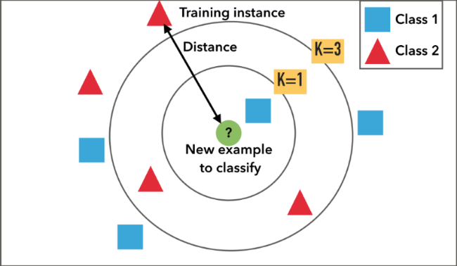
KNN, or Nearest Neighbor Algorithm
A learning algorithm that classifies based on the closest neighbors from the training set
Given a test dataset, the algorithm searches for k of the closest neighbors for each variable
It sums all the classifications of the closest variables. Then the algorithm will choose the classification with the largest count.
For example, in the figure to the right, when k = 1, the classification would be class 1. But when k = 3, there are two instances of class 2 and only one of class 1, so the algorithm would choose a class 2 classification.
Notes:
Pic source: https://blog.usejournal.com/a-quick-introduction-to-k-nearest-neighbors-algorithm-62214cea29c7

Slide 17
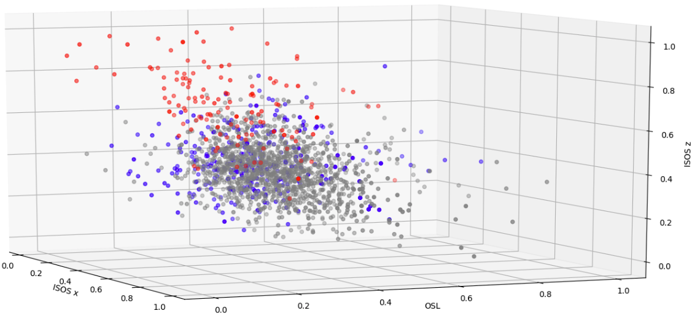

Why KNN?
S cone clusters like this one should make the KNN algorithm successful
KNN is an excellent algorithm when classification clusters are very clear.
In this case, we noticed that for certain parameters, the short cones were forming satisfactory clusters.
We did not expect it to differentiate M and L cones from each other.

Slide 18
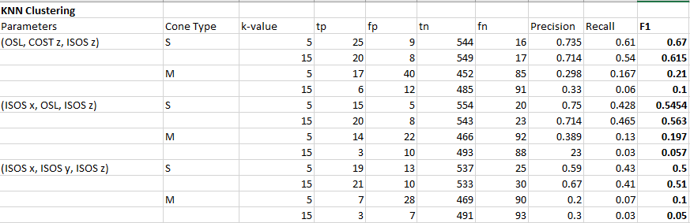
KNN Results
Tested k values of 5 and 15 for both S and M cones
The precision scores above .7 are promising, but recall values were lower than ideal
Very inaccurate in identifying M cones (as predicted)

Slide 19
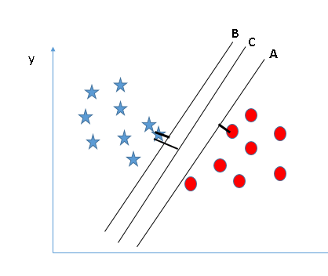
Support Vector Machine (SVM)
An algorithm that creates a hyperplane that best separates the variables.
In proper terminology, the “support-vectors” are the data points in the training set, and the “machine” is the line or hyperplane that segregates the classes.
When there is more than two variables, multiple hyperplanes are used to create the proper amount of classes
Identifying the best hyperplane results from comparing Margins
In the example graph, C is the best machine because it has the largest distance between class 1 and 2 while also successfully separating the classes
Class 1
Class 2
Example graph
Notes:
Pic source: https://www.analyticsvidhya.com/blog/2017/09/understaing-support-vector-machine-example-code/

Slide 20
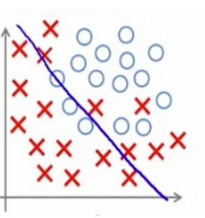
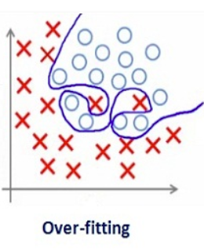
Why SVM? And why a Linear Machine?
SVM is also good at recognizing clusters, so it should be able to identify most S cones.
Expected to have trouble identifying M cones like the KNN algorithm
We decided to use a linear machine to avoid overfitting problems that can be caused by a non-linear machine.
A non-linear SVM was done in a previous experiment by Ryan Danehy and Brandon Fischer, who concluded that it results in overfitting.
A comparison to the KNN algorithm would be interesting. We can determine which clustering algorithm is better in our scenario.
Linear example
Notes:
Github source for Danehy and Fischer’s experiment: https://github.com/cloudmesh-community/sp19-222-89/blob/master/project-report/report.md

Slide 21
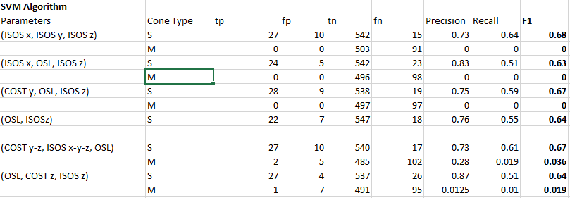
Support Vector Machine Results
Very Consistent F1 Scores across different parameters
Trouble identifying Medium Cones
Again, precision score was good, but recall wasn’t
Generally better results than KNN

Slide 22
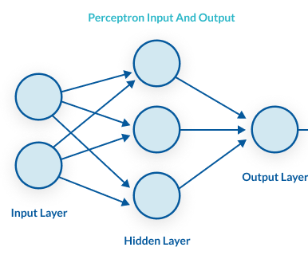
A New Approach: Multilayer Perceptron Neural Networks
As the name states, the multilayer perceptron network is a network with at least three layers of nodes.
The basic concept is that the network has an input layer, output layer, and hidden layers in between.
Input layers are the variables we put into the network with their classification already known (from the training data set).
The output layers are the classification result that the model produces.
The hidden layers are how the model produces an output. It uses an activation function to produce an output, either to the next hidden layer in sequence or to the output layer if no hidden layers remain.
Activation function creates output from node
Notes:
Pic source: https://missinglink.ai/guides/neural-network-concepts/perceptrons-and-multi-layer-perceptrons-the-artificial-neuron-at-the-core-of-deep-learning/

Slide 23
Differences in the Neural Network From Cluster Algorithms
Its hidden layers allow it to detect complex and nonlinear relationships.
Data points don’t have to be clustered for it to work effectively.
This could potentially help find separation between M and L cones
It is better able to deal with outlying cones
S cones whose traits are more like other M and L cones have a higher chance of being correctly identified by the Neural Network
Note: a multi perception net is still supervised; it will produce a classification of S, M or L. A deep learning network is unsupervised and would likely produce more consistent results if explored; however, this is not the goal of the project.

Slide 24
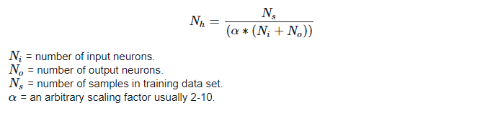
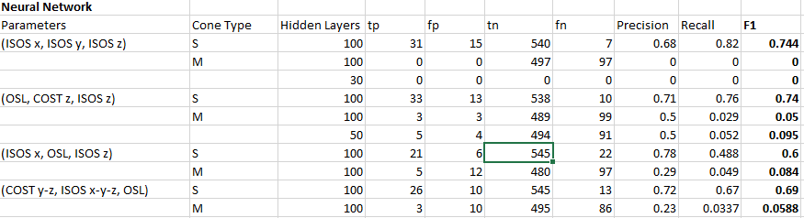
Neural Network Results
Hidden Layers
In general we used 100 hidden layers for each classification
This number was decided on this formula
Produced the best Results of all Algorithms
More consistent F1 Scores with notably higher recall scores
Unable to recognize M cones, which was disappointing
Max # of hidden layers
Notes:
Hidden Layers – layer between input and output layers where artificial neurons take a set of weighted inputs and produce an output through activation function

Slide 25
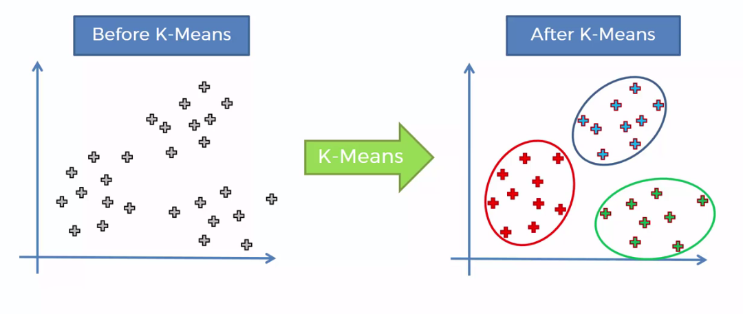
K Means Clustering
This algorithm attempts to cluster the training data into a specified amount of even clusters (k).
Since we know we want only 3 clusters representing S, M and L, this method would be easy to test.
A three-way cluster would produce a lot more M cone results
Could potentially help identify a distinction between M and L cones
This method is not expected to identify S cones as well as the previous algorithms, but is expected to produce more prominent M cone results
Notes:
Pic source: https://www.superdatascience.com/blogs/self-organizing-maps-soms-extra-k-means-clustering-part-3/

Slide 26
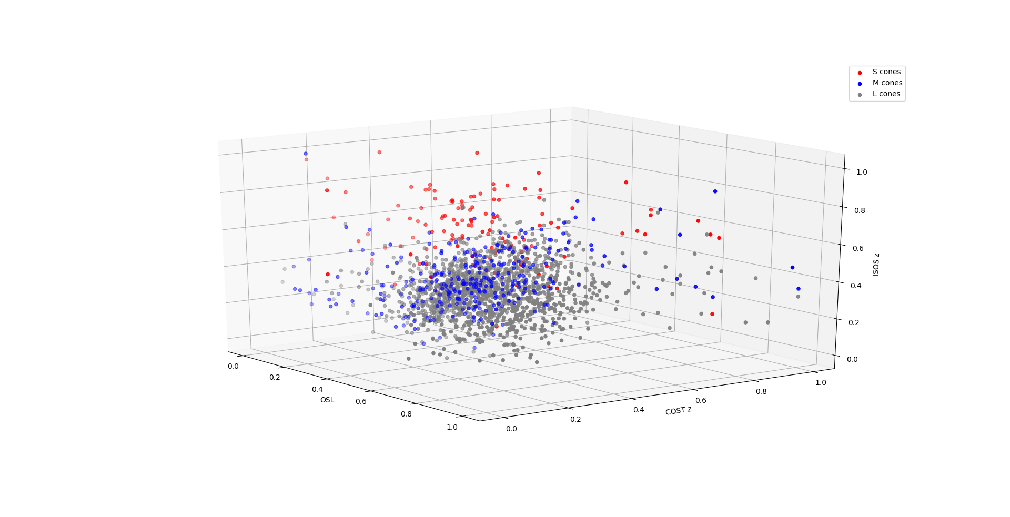
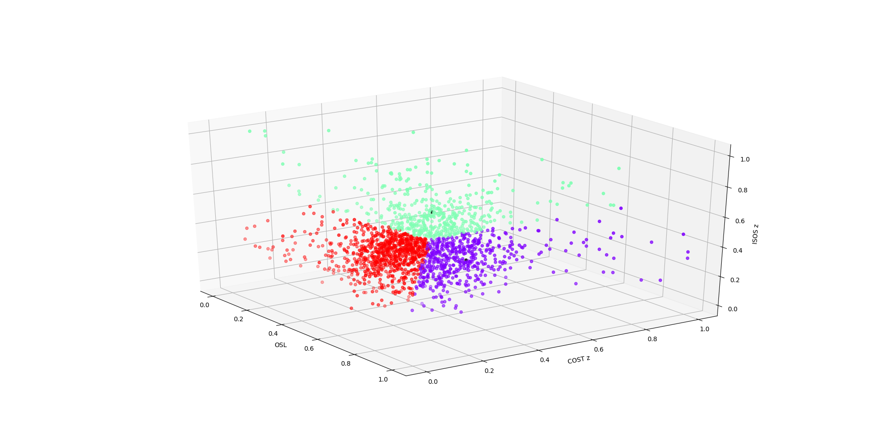

Issues With This Algorithm
Because the clusters produced by this algorithm were evenly distributed, it created a few problems in the results.
The distribution of cones in the training set were not even (L cones were much more frequent than M and L), so the cluster created more S and M cones than necessary.
The distribution of cones in the test set were also similar, so the algorithm produced a lot of false positives.
Green = Short
Red = Medium
Purple = Long
Note that the post cluster identifies a lot more S and M cones than original
Pre-cluster
Post-cluster

Slide 27

K Means Clustering Result
Can recognize M cones slightly more successful than other algorithms
Still not to a sufficient extent
Many false positives, extremely low precision
F1 scores not nearly high enough
A way to distribute the cluster so that they reflect training data distribution of S, M, and L cones may work better, but this method would likely be overshadowed by the other two clustering methods (KNN and SVM)

Slide 28
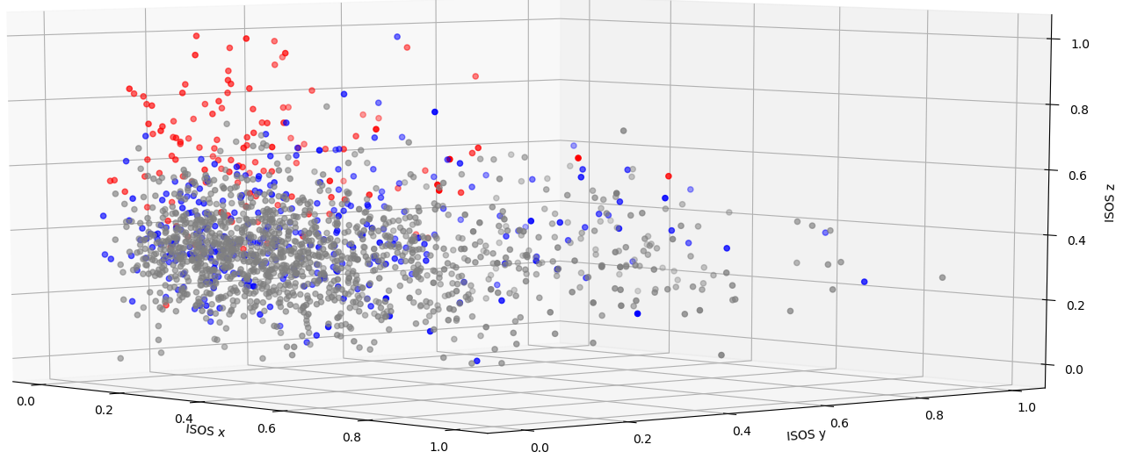
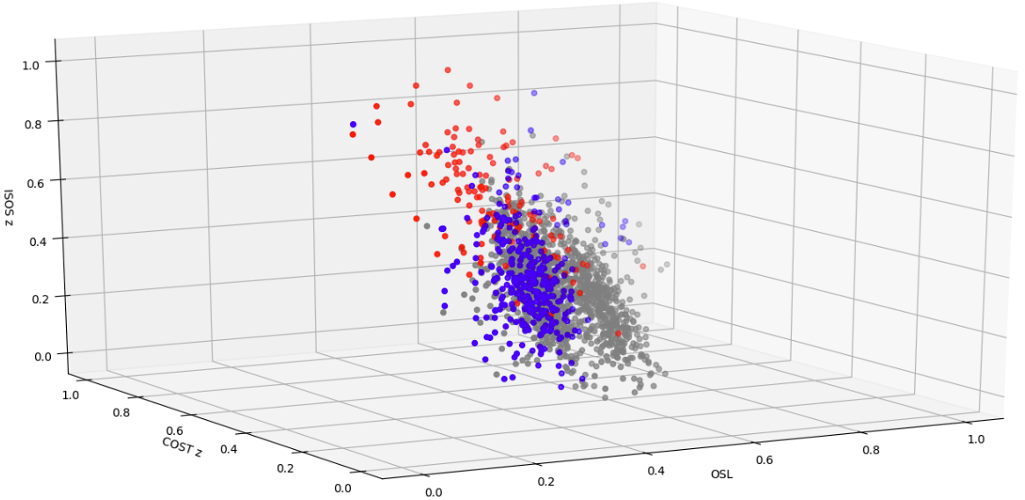
Overall Conclusion
Having 8 of 9 variables test significant for cone type was surprising to Dr. Miller’s lab.
Furu Zhang is re-analyzing samples to confirm the correctness of the data
Using several different classification algorithms (KNN, SVM, Neural Net), these variables were found sufficient for distinguishing S from M and L cones (F1 ~ .7), but not sufficient for distinguishing M from S and L cones (F1 ~ .05).
The parameters that generated the highest F1 Scores were: (ISOS x, ISOS y, ISOS z) and (OSL, COST z, ISOS z), indicating that these parameters are the most effective in distinguishing S cones.
Surprisingly, Multi-dimensional parameters (>3) were not as effective on any of the algorithms

Slide 29
Future work
Current algorithm performance is limited by S cone outliers in dataset
Lowers F1 score in testing
KNN and SVM algorithms are poor for distinguishing outliers
A way to identify these outliers would be very useful
Given more variables, Neural Networks have the most potential in separating S cones
Would be interesting to test with many different combinations of parameters
Unsupervised neural network could be most beneficial, but would lose insight of the most important variables…

